Slide 1
CAPSTONE PROJECT
AIRLINES BOOKING ANALYSIS
Presented By:
STUDENT NAME : SANKEERTHAN L
COLLEGE NAME : ANNA UNIVERSITY
DEPARTMENT : BTECH CHEMICAL ENGINEERING

Slide 2
OUTLINE
PROBLEM STATEMENT
PROPOSED SYSTEM/SOLUTION
SYSTEM DEVELOPMENT APPROACH
ALGORITHM & DEPLOYMENT
RESULT
CONCLUSION
FUTURE SCOPE
REFERENCES

Slide 3
PROBLEM STATEMENT
Optimizing Airline Booking Strategies. Airline is experiencing a decline in profitability over the past year. This decline is due to a number of factors, including increased fuel costs, competition from low-cost carriers, and a decrease in passenger demand. Analyze the data and provide a suitable ways to use Airline.

Slide 4
PROPOSED SOLUTION
The program should handle various scenarios such as:-
This analysis aims to identify patterns in airline booking data for the following relationships:
Trip Type vs. Passenger: We need to understand how trip type (round trip, one-way, multi-city) varies based on passenger demographics (age, business/leisure travel) to better tailor marketing and pricing strategies for different customer segments.
Sales Channel vs. Purchase Lead Time: By analyzing the sales channels (direct website, travel agent, online travel agency) used and the corresponding purchase lead time (days before departure), we can identify the most effective channels for influencing booking decisions at different stages of the travel planning process.
Flight Day vs. Length of Stay: Understanding the relationship between the day of the week a flight is booked (weekday vs. weekend) and the passenger's chosen length of stay can help airlines optimize scheduling and pricing for different travel patterns (business trips vs. vacations).
Flight Day vs. Purchase Lead Time: Analyzing how the day of the week a flight is booked affects the purchase lead time can reveal patterns in booking behavior. This can be used to tailor targeted promotions and marketing campaigns based on the specific day of the week.

Slide 5
PROPOSED SOLUTION
Key Features:
Increase bookings: Identify preferred trip types, sales channels, and flight days for different passenger segments.
Optimize pricing: Develop dynamic pricing models that consider booking patterns and purchase lead time.
Improve marketing effectiveness: Target marketing campaigns based on passenger demographics, sales channels, and booking behavior.
This data analysis will ultimately contribute to maximizing revenue, seat utilization, and passenger satisfaction.

Slide 6
SYSTEM APPROACH
Technologies Used:
Python programming language for backend development.
GUI framework like Tkinter or PyQt for frontend interface.
SQLite or MySQL for database management.
GitHub for version control and collaboration.

Slide 7
ALGORITHM & DEPLOYMENT
ALGORITHM:
Descriptive Statistics: Calculate summary statistics (mean, median, standard deviation, frequency tables) to understand the basic properties of the data for each relationship.
Visualization Techniques: Create charts and graphs (histograms, scatter plots, boxplots) to visualize trends, patterns, and potential relationships between variables.
Chi-Square Test: Assess the statistical independence between categorical variables (e.g., trip type vs. passenger type, sales channel vs. purchase lead time, flight day vs. length of stay).
Logistic Regression: Model the probability of a passenger choosing a particular trip type or sales channel based on their demographics or purchase lead time.
Decision Trees: Classify passengers into distinct segments based on their booking characteristics to identify targeted marketing opportunities.
Time Series Analysis: Analyse booking patterns over time (e.g., seasonality effects) to inform scheduling and pricing decisions (flight day vs. purchase lead time).

Slide 8
ALGORITHM & DEPLOYMENT
DEPLOYMENT ON GITHUB:
Create a GitHub Repository: Create a new repository on GitHub to store your code and analysis results.
Jupyter Notebook or Python Scripts: Use Jupyter Notebooks for interactive data exploration and visualization, or create well-structured Python scripts for modular code.
Version Control: Use Git to commit your code regularly, tracking changes and allowing for collaboration if needed.
README File: Include a README file that explains the project's purpose, data sources, analysis steps, and key findings.

Slide 9
ALGORITHM & DEPLOYMENT
USING KAGGLE FOR DATA:
Explore Kaggle Datasets: Search Kaggle for relevant airline booking datasets. Consider factors like data quality, size, and alignment with your analysis goals.
Download and Preprocess: Download the chosen dataset(s) and preprocess them in your Python environment to ensure compatibility with your analysis. This might involve handling missing values, converting data types, and potential feature engineering.
ADDITIONAL CONSIDERATIONS:
Data Privacy: Ensure responsible data handling practices, especially if using real-world datasets with potentially sensitive passenger information. Anonymize data when necessary, and comply with relevant data privacy regulations.
Model Evaluation: When using models (e.g., logistic regression), evaluate their performance using metrics appropriate for the task (e.g., accuracy, precision, recall) to assess their effectiveness.
Airline-Specific Considerations: The analysis might require adjustments depending on the airline's specific business model, target market, and booking platform.

Slide 10
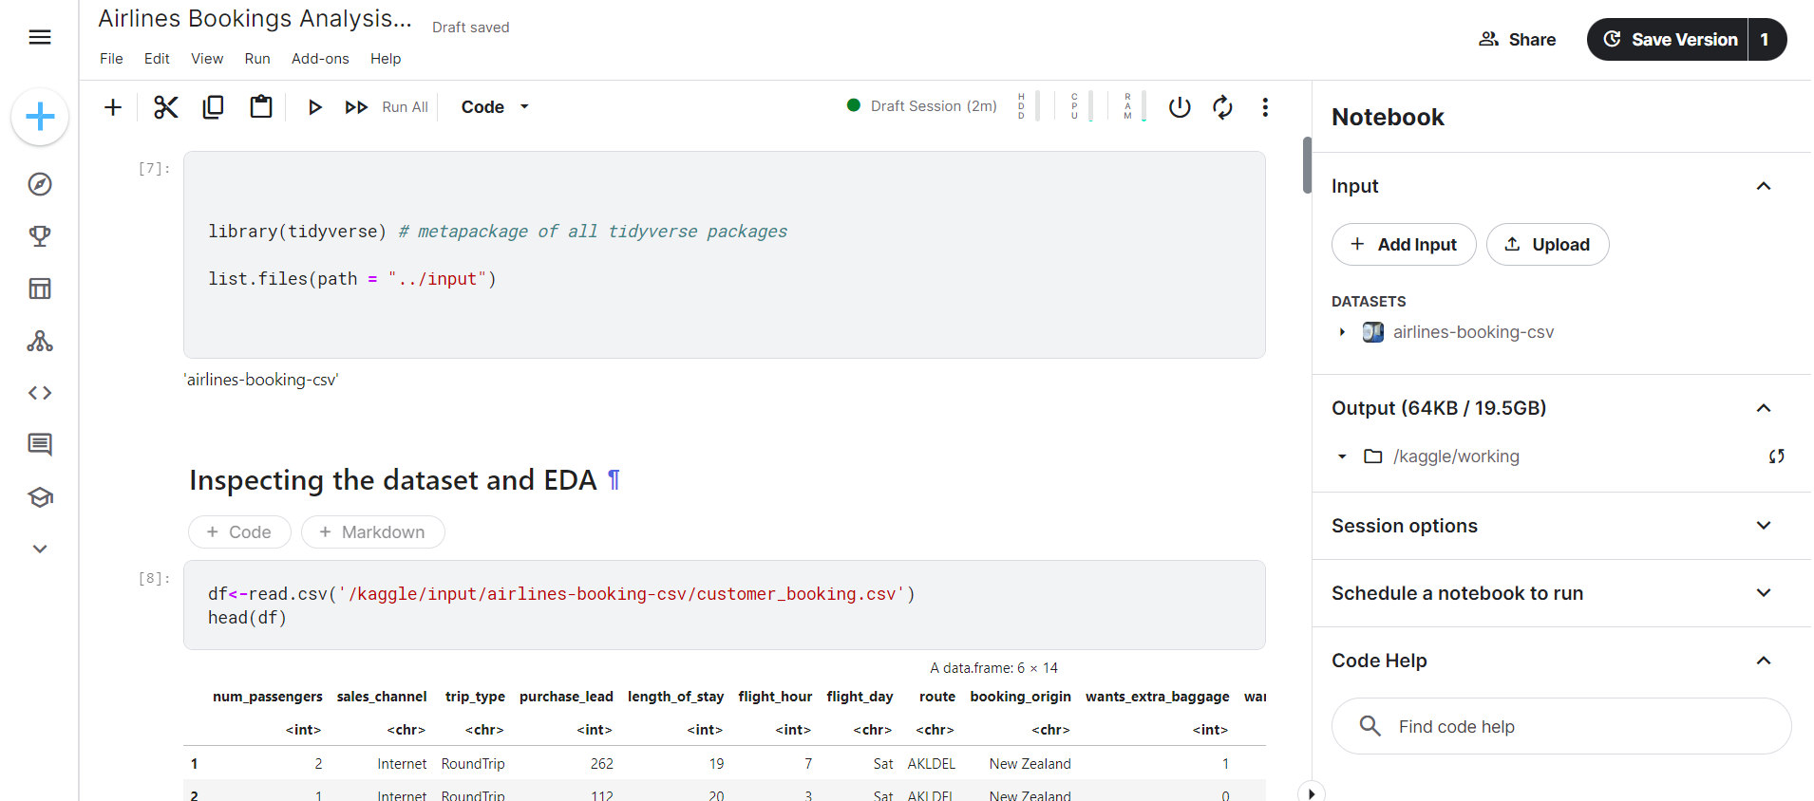
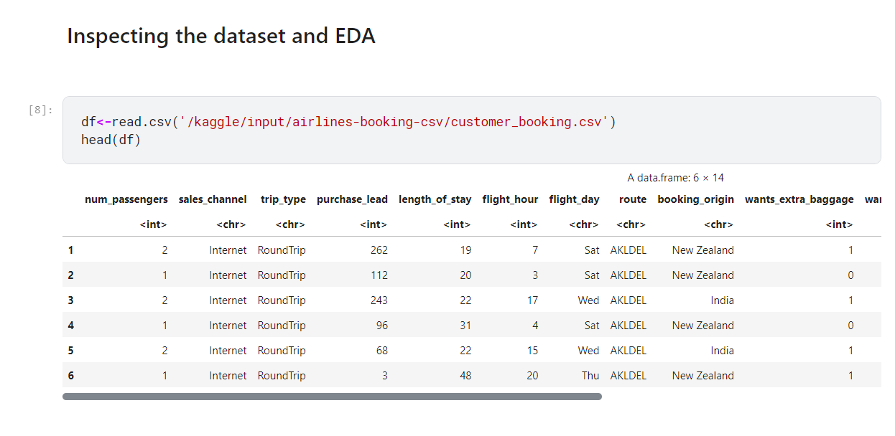
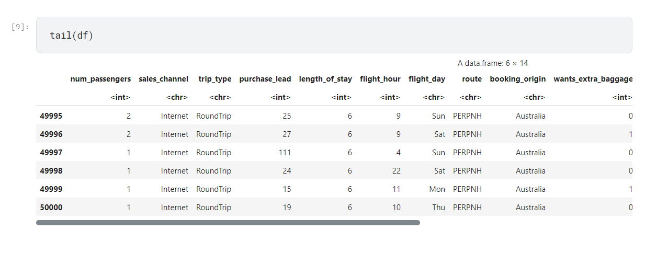
RESULT
1
1
2
3

Slide 11
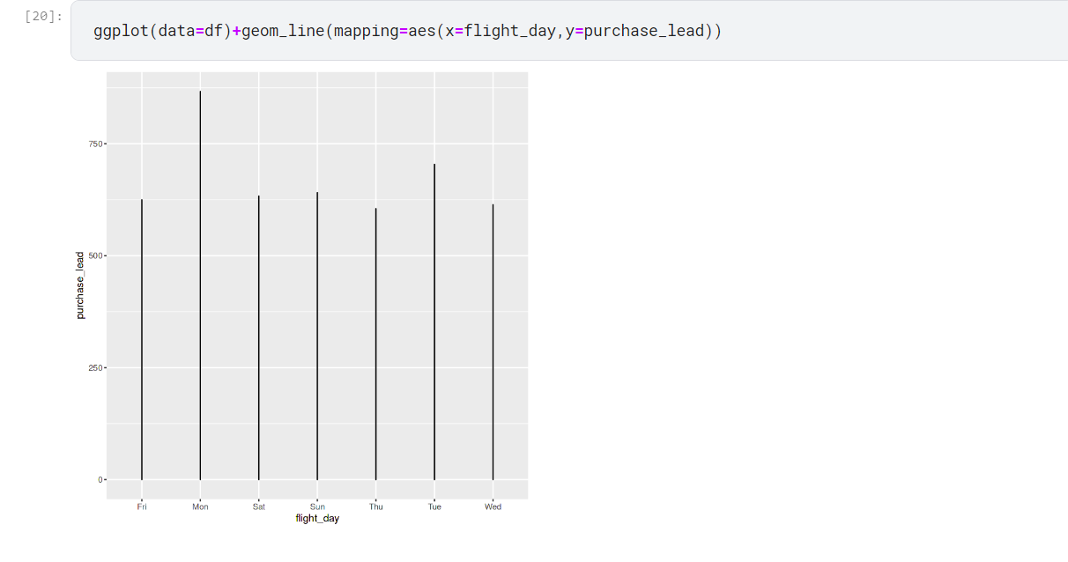
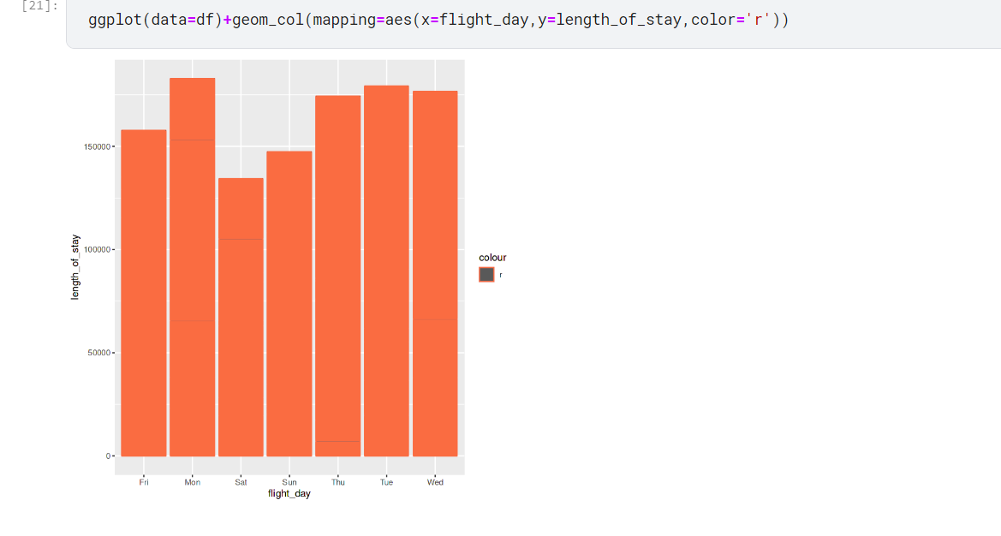
RESULT
5.(FLIGHTDAY VS LENGTH OF STAY)
4.(FLIGHTDAY VS PURCHASE LEAD)

Slide 12
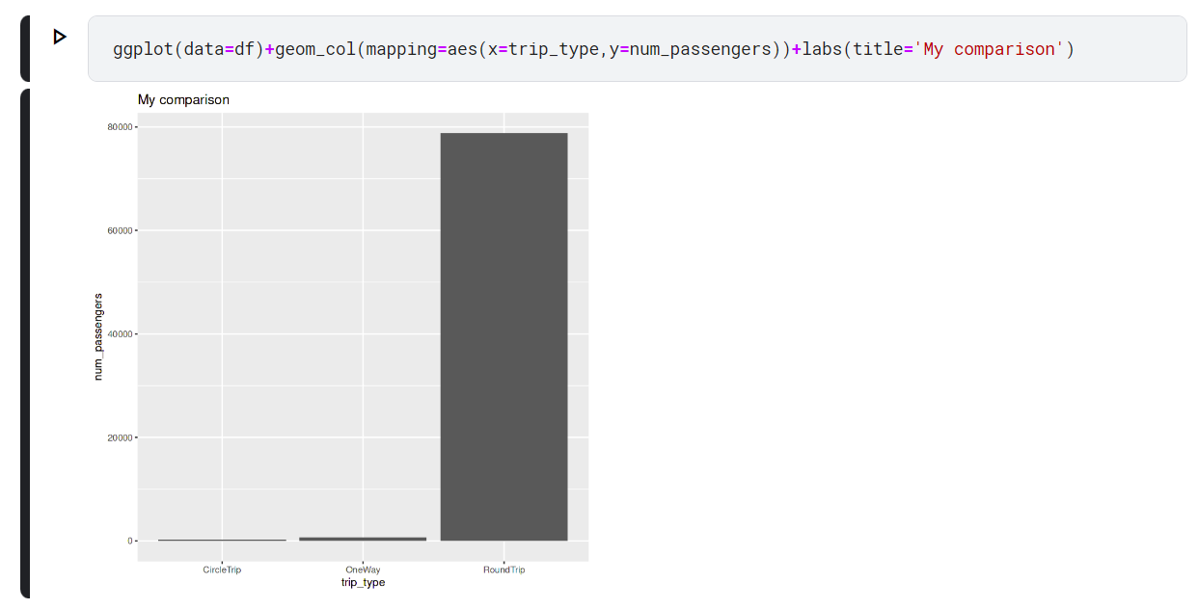
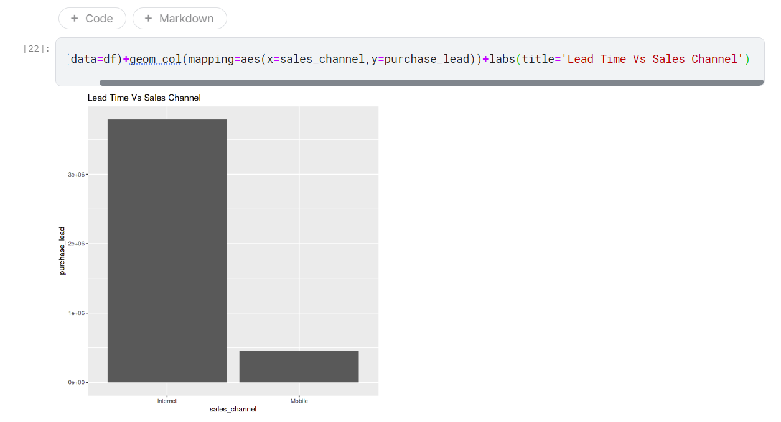
RESULT
7.(LEAD TIME VS SALES CHANNEL)
6.(TRIP TYPE VS PASSENGERS)

Slide 13
CONCLUSION
By analysing these relationships in airline booking data, we can gain valuable insights into passenger behaviour. This will enable data-driven strategies to improve revenue, seat utilization, and ultimately, passenger satisfaction. This analysis can be a powerful tool for airlines to optimize their operations and marketing efforts.

Slide 14
FUTURE SCOPE
Uncover Booking Preferences: Identify preferred trip types (round trip, one-way, multi-city) and sales channels (direct website, travel agent, online travel agency) based on passenger demographics and booking behaviour.
Optimize Pricing Strategies: Develop dynamic pricing models that consider booking patterns, purchase lead time (days before departure), and flight day (weekday vs. weekend) to maximize revenue and seat utilization.
Target Marketing Campaigns: Tailor marketing campaigns to specific passenger segments based on their demographics, preferred sales channels, booking behaviour, and chosen flight day.

Slide 15
REFERENCES
“Global Airline Online Booking Market Analysis Report 2022: Overall Online Travel Booking Experience is Still Not Optimal” - ResearchAndMarkets.com
https://www.kaggle.com/datasets/anandshaw2001/airlines-booking-csv/data
“An Airline Case Study Analysis” By Bill Inmon.

Slide 16
THANK YOU

